Slide 1
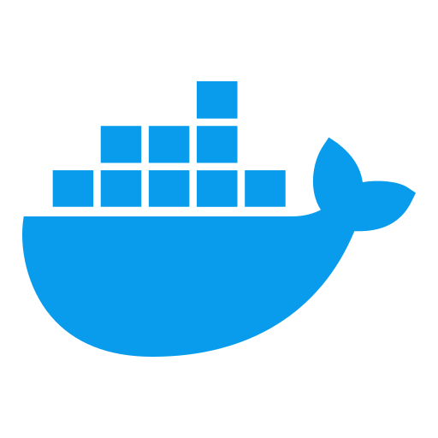
MODULE 5: DOCKERFILE MASTERY & IMAGE CREATION
Docker & Containerization Workshop
By TALHA

Slide 2
Learning Objectives
Design and implement efficient Dockerfiles for various application types
Master multi-stage builds for optimized image creation
Implement image creation best practices for security and efficiency

Slide 3
Dockerfile Fundamentals
Basic Structure
FROM base-image
LABEL maintainer="name@example.com"
# Setup instructions
RUN command
COPY files
# Runtime instructions
EXPOSE port
CMD ["executable", "param1", "param2"]
What is a Dockerfile?
Text document with instructions to build an image
Each instruction creates a layer in the image
Layers are cached for efficient rebuilds

Slide 4
Base Instructions Deep Dive
FROM
Specifies base image (alpine, ubuntu, node:16, etc.)
Minimal, secure bases preferred
FROM scratch for from-scratch images
FROM ubuntu:22.04
FROM node:16-alpine
ARG vs. ENV
ARG: Build-time variable, not available in container
ENV: Sets environment variable, persists in container
ARG VERSION=latest
FROM base:${VERSION}
ENV APP_HOME=/app ENV PATH=$APP_HOME/bin:$PATH

Slide 5
Filesystem Instructions
COPY vs. ADD
COPY: Simple file copying from build context
ADD: Has additional features (URL download, tar extraction)
Best practice: Prefer COPY unless ADD features needed
COPY src/ /app/src/
ADD http://example.com/file.tar.gz /tmp/
WORKDIR
Sets working directory for subsequent instructions
Creates directory if it doesn't exist
Best practice: Use absolute paths
WORKDIR /app
# Now all RUN, CMD, etc. execute in /app

Slide 6
Volume and Execution Instructions
VOLUME
Declares mount points for external storage
Data persistence beyond container lifecycle
VOLUME /data /logs
EXPOSE
Documents ports the container listens on
Does not actually publish ports (done at runtime)
EXPOSE 80 443

Slide 7
RUN Instruction Optimization
Purpose: Execute commands during build
Optimization Techniques
Chain commands with && to reduce layers
Clean up in the same layer that creates artifacts
Use --no-install-recommends for apt
# Bad: Multiple layers
RUN apt-get update
RUN apt-get install -y package1
RUN rm -rf /var/lib/apt/lists/*
# Good: Single layer
RUN apt-get update && \
apt-get install -y --no-install-recommends package1 && \
rm -rf /var/lib/apt/lists/*

Slide 8
CMD vs. ENTRYPOINT
CMD: Default command to run when container starts
Easily overridden at runtime
Three forms: exec, shell, default parameters
CMD ["executable", "param1"] # exec form (preferred)
CMD command param1 # shell form
ENTRYPOINT: Container as executable
Less easily overridden (requires --entrypoint)
CMD becomes default parameters
ENTRYPOINT ["nginx", "-g", "daemon off;"]
# CMD parameters appended to ENTRYPOINT

Slide 9
User, Healthcheck & Shell Instructions
USER
Sets user for subsequent RUN, CMD, ENTRYPOINT
Security best practice: avoid running as root
RUN groupadd -r app && useradd -r -g app app
USER app
SHELL
Changes shell used for shell-form instructions
SHELL ["/bin/bash", "-c"]
HEALTHCHECK
Defines container health check
HEALTHCHECK --interval=30s --timeout=5s \
CMD curl -f http://localhost/ || exit 1

Slide 10
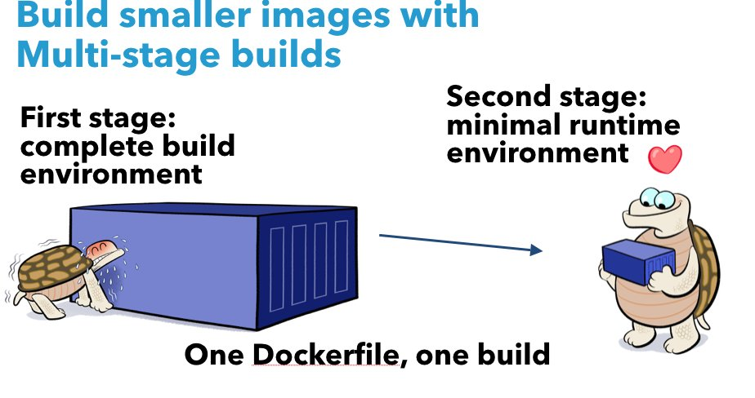

Slide 11
Multi-Stage Build Concept
The Problem:
Build artifacts vs. runtime needs
Build tools increase image size
Development dependencies not needed in production
Sensitive information in build environment
The Solution:
Multi-stage builds
Separate build and runtime stages
Copy only necessary artifacts between stages
Significantly smaller final images
Better security posture

Slide 12
Multi-Stage Build Syntax
Basic Structure
# Build stage
FROM node:16 AS builder
WORKDIR /app
COPY package*.json ./
RUN npm install
COPY . .
RUN npm run build
# Runtime stage
FROM node:16-alpine
WORKDIR /app
COPY --from=builder /app/dist ./dist
COPY --from=builder /app/package.json .
RUN npm install --only=production
CMD ["node", "dist/app.js"]

Slide 13
Multi-Stage Build Advanced Techniques
Intermediate Stage Naming and Targeting
FROM ubuntu AS base
FROM base AS build
RUN apt-get update && apt-get install -y build-essential
FROM base AS test
RUN apt-get update && apt-get install -y python-pytest
FROM base AS prod
COPY --from=build /app/binary /app/
Build specific stage: docker build --target test .

Slide 15
Language-Specific Optimizations
Java Application Example
# Build stage - uses JDK
FROM eclipse-temurin:17-jdk AS builder
WORKDIR /app
COPY . .
RUN ./mvnw package -DskipTests
# Runtime stage - uses JRE only
FROM eclipse-temurin:17-jre
WORKDIR /app
COPY --from=builder /app/target/app.jar ./
CMD ["java", "-jar", "app.jar"]
Python, Node.js, Go patterns follow similar approach
Compile/build in one stage
Run in minimal environment

Slide 16
Distroless and Minimal Base Images
Distroless Images
Contains application and runtime dependencies only
No package manager, shell, or common Linux utilities
Smaller attack surface, smaller size
FROM node:16 AS builder
# ... build steps ...
FROM gcr.io/distroless/nodejs:16
COPY --from=builder /app/dist /app
CMD ["app/server.js"]
Alpine vs. Slim vs. Distroless vs. Scratch
Trade-offs: size, security, debugging capability

Slide 17
Security Best Practices
Non-root User
RUN groupadd -r appuser && useradd -r -g appuser appuser
USER appuser
Minimal Base Images
Alpine, distroless, or purpose-built bases
Secrets Management
Don't embed secrets in images
Use BuildKit secret mounting
RUN --mount=type=secret,id=mysecret cat /run/secrets/mysecret
Image Scanning
Regularly scan for vulnerabilities (Trivy, Clair, Docker Scout)

Slide 18
Build Performance Optimization
BuildKit Features
Parallel execution of independent build stages
Improved caching
Secret mounting
# Enable BuildKit export DOCKER_BUILDKIT=1
.dockerignore File
Exclude files not needed in build context
.git node_modules *.log
Layer Caching Strategy
Order instructions from least to most frequently changed

Slide 19
Hands-on Exercise: Creating Efficient Dockerfiles
Exercise Objectives
Create a multi-stage Dockerfile for a Java application
Implement security best practices
Optimize image size and build performance
Steps
Write initial Dockerfile
Measure image size and layers
Refactor to multi-stage build
Implement security hardening
Compare before/after metrics

Slide 20
Hands-on Exercise: Dockerfile Analysis
Exercise Objectives
Analyze existing Dockerfiles for improvement opportunities
Apply best practices to reduce security risks
Implement layer optimization
Steps
Examine provided Dockerfiles
Identify security issues
Optimize layer structure
Implement multi-stage pattern
Validate with build and scan

Slide 21
Key Takeaways
Efficient Dockerfiles lead to smaller, more secure images
Multi-stage builds separate build and runtime concerns
Layer optimization improves build and pull performance
Security best practices should be applied consistently
Enterprise standardization enables governance at scale

Slide 22

Questions?

